Slide 1


YELP ANALYTICS
GROUP D

Slide 2

Agenda
Objectives
Data Source & Model
Project Challenges
Strategy & Technology
Spark Jobs & Map Reduce
Tableau Visualizations
Conclusion

Slide 3
Problem definition
Finding out strategic solutions for leveraging Yelp’s community and user engagement for upscaling their businesses.

Slide 4

Objectives
The objective of this project is to help Yelp by analyzing the Yelp dataset and gaining insights into various aspects of businesses, users, and reviews.
The analysis aims to extract valuable information such as top-rated businesses, user behaviours, popular business categories, geographic trends, and more.
The project aims to use data exploration, visualization, and statistical analysis techniques to uncover patterns and trends within the Yelp dataset.

Slide 5
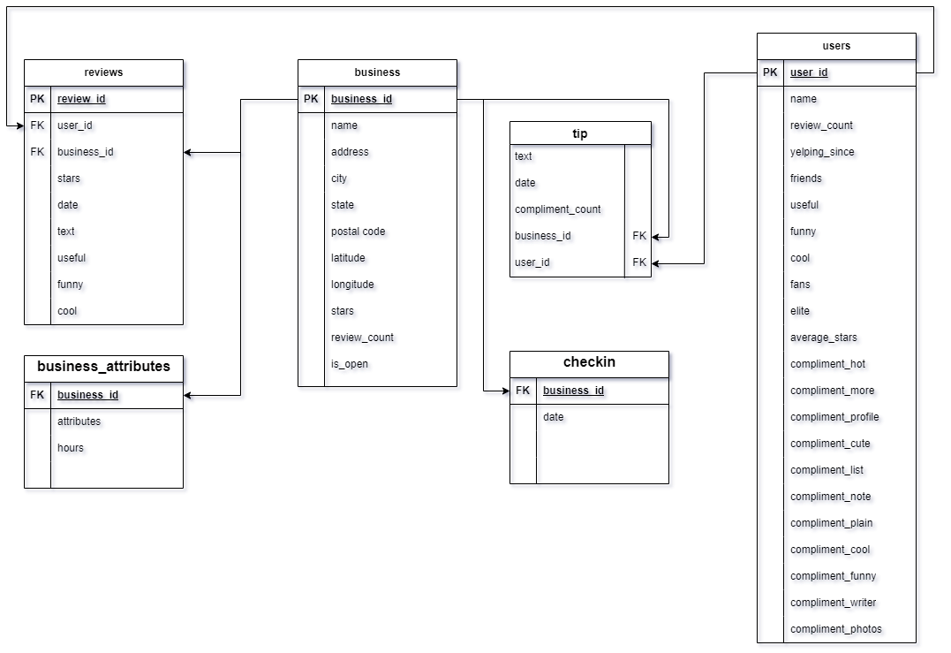
Data Source & Model
50% target sales increase in the following the data source for this project is the Yelp dataset, which is a collection of data related to businesses, users, and reviews from the Yelp platform.
The dataset includes business information such as their names, categories, locations, and star ratings. It also contains user profiles with details like user IDs, names, review counts, and average star ratings. Additionally, the dataset includes individual reviews that users have left for businesses, along with associated star ratings.
Link: https://www.yelp.com/dataset
Size : 9.29 GByear

Slide 6

Project Challenges
LARGE DATASET
DATA CLEANING
JSON FILES
PROCESSING AND STORAGE
SPARK JOBS
MAP REDUCE

Slide 7

Strategy & Technology
Cloud Notebooks
Basic Exploratory Data Analysis
Pin-pointing problem statement
Bigquery
Dataproc
Tableau
PySpark & MapReduce

Slide 8

Spark Jobs & Map Reduce

Slide 9
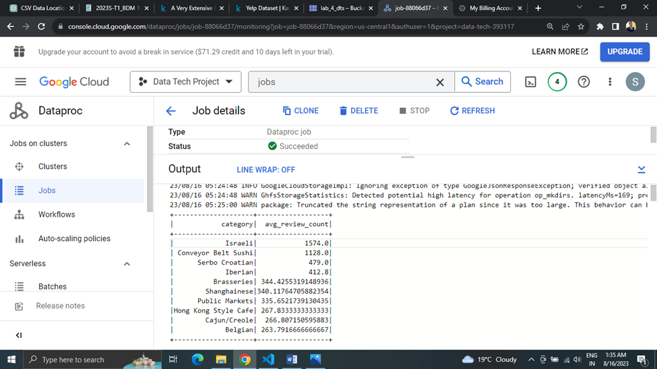
The average review count for businesses in each category and the top 10 categories with the highest average review counts.

Slide 10
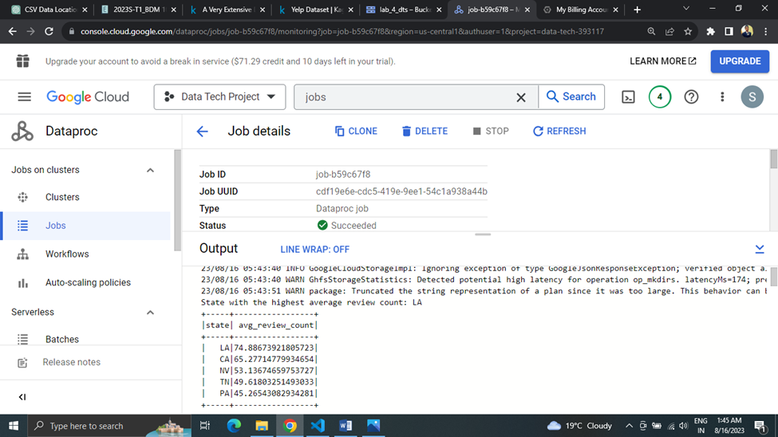
The average review count for businesses in each state, along with the highest average review count state-wise and the top 5 states with the highest average review counts.

Slide 11
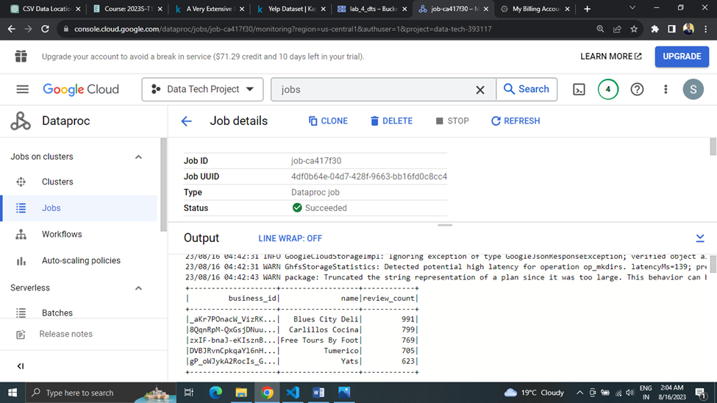
The top 5 Business with most number of 5 Star rating with the total review.

Slide 12
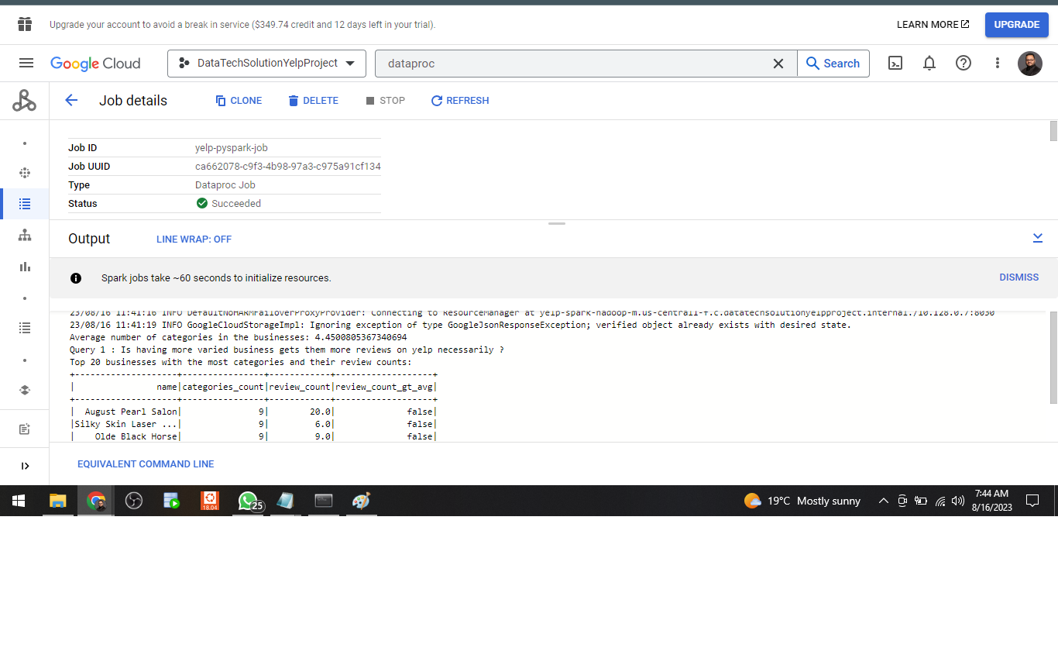
Top 20 categories with the most number of business and their review counts

Slide 13
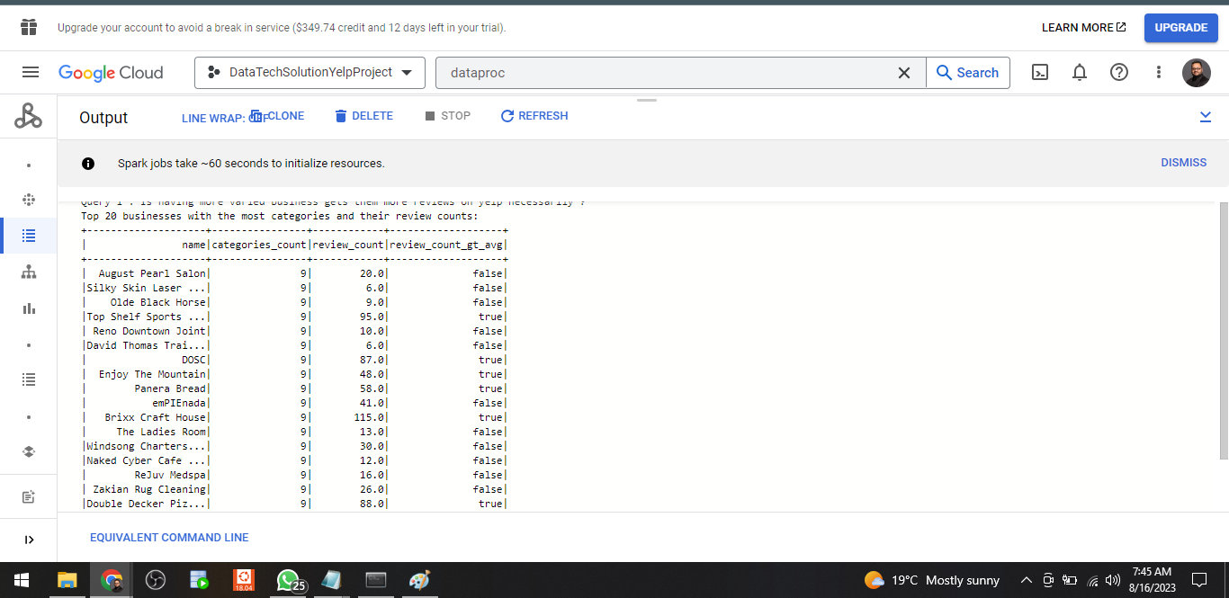

Slide 14
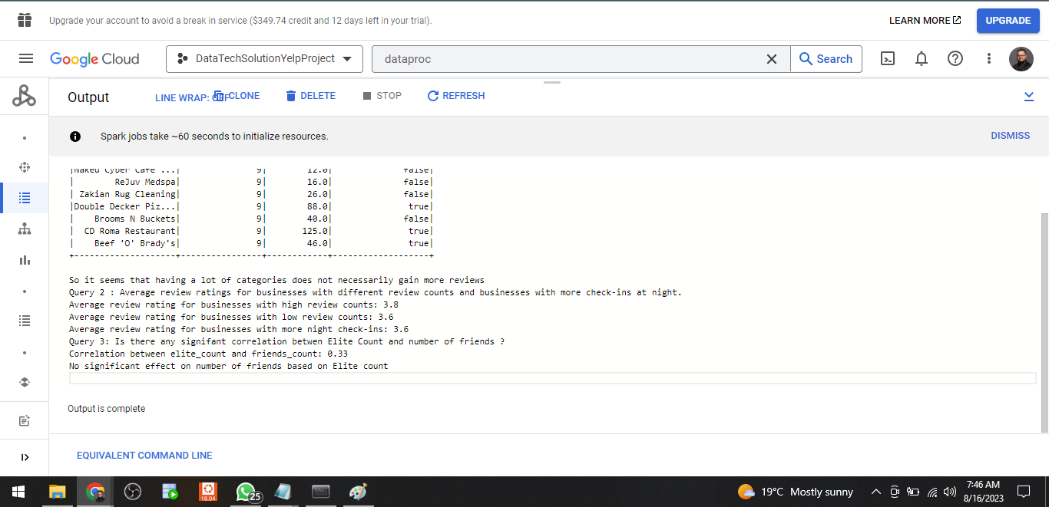

Slide 15
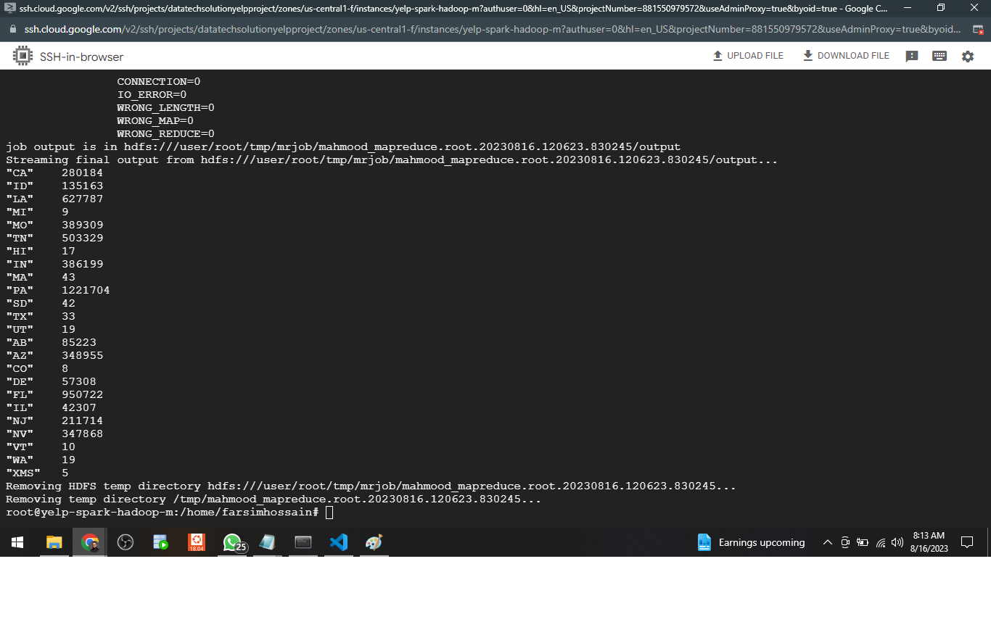
Map Reduce job calculates the total review count per state for businesses that are marked as open.

Slide 16
Tableau Visualizations

Slide 17
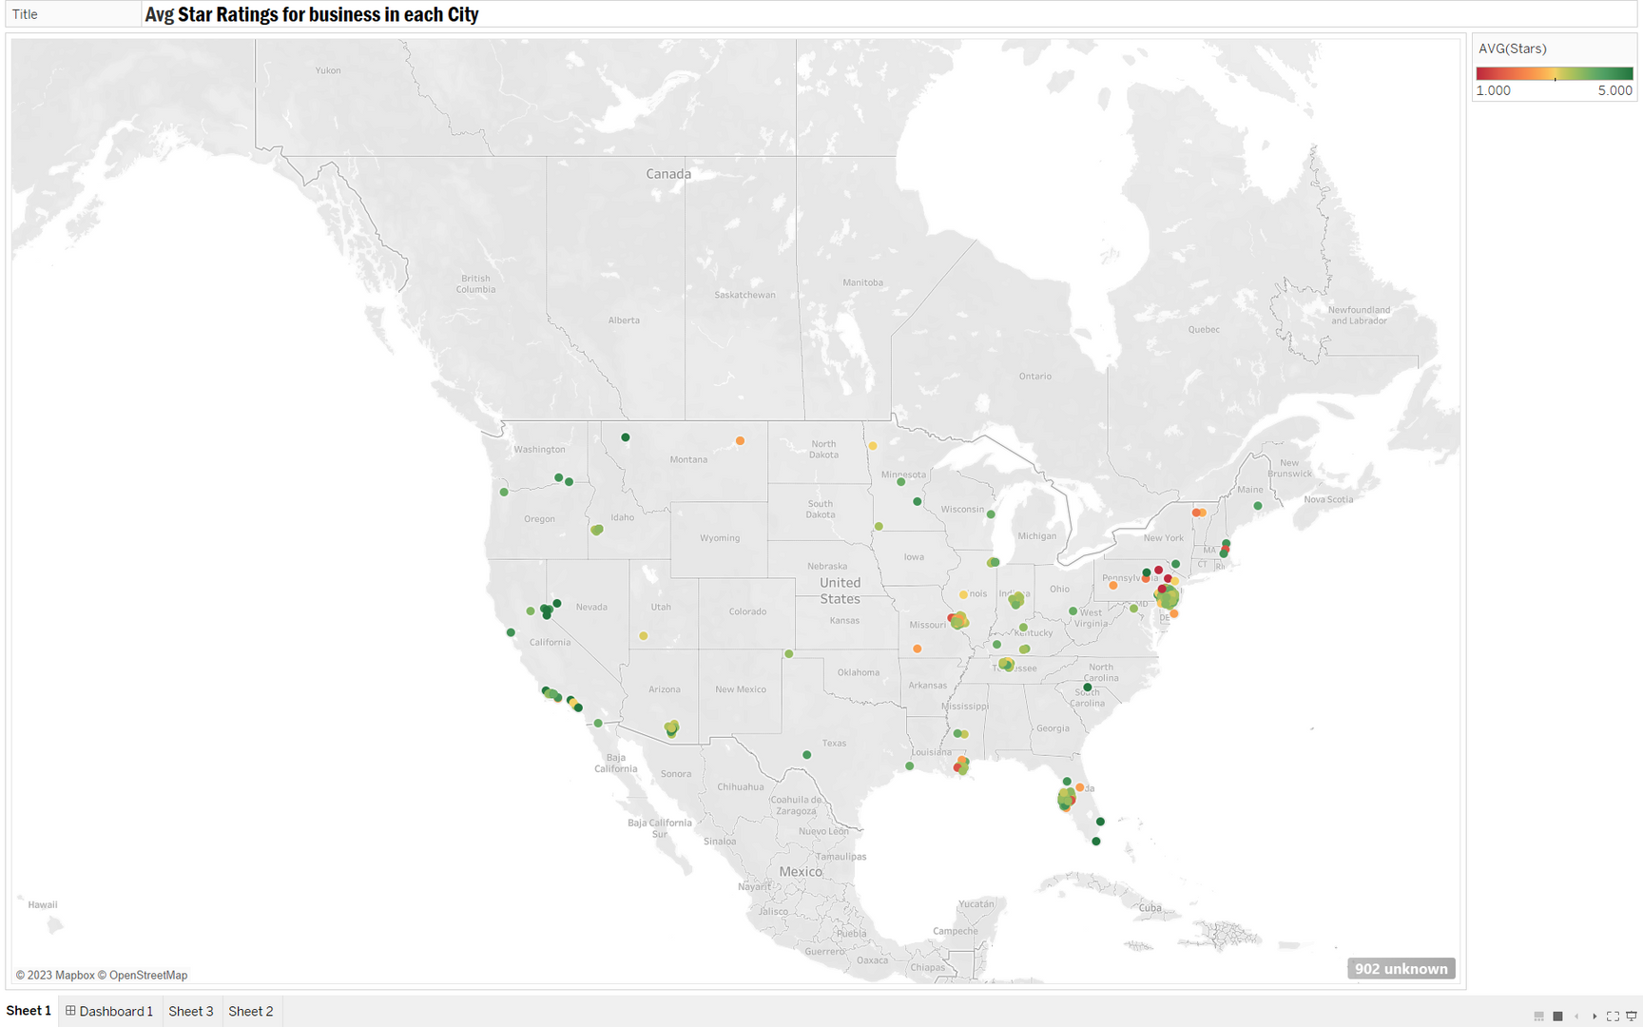
Geographic Business Distribution
The map visualizes the geographical distribution of businesses, helping us identify regions with high and low business concentrations. This insight aids in understanding the overall economic landscape and potential market opportunities.

Slide 18
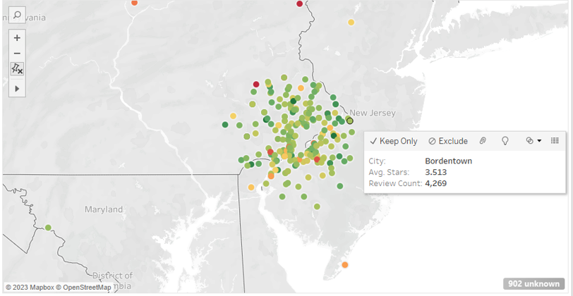
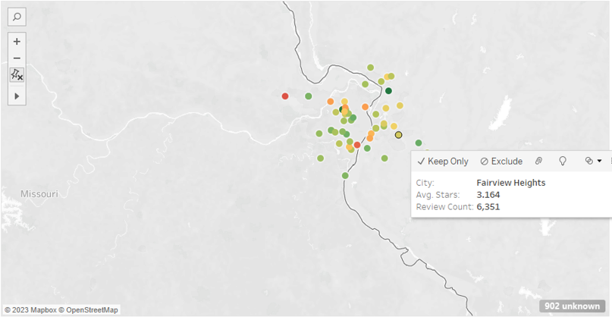
Rating Analysis through Color Gradient
By using color gradients for star ratings, you can quickly assess businesses' overall ratings.
The color spectrum highlights exceptional and poorly rated businesses, allowing you to make informed decisions about where to dine, shop, or engage in services.

Slide 19
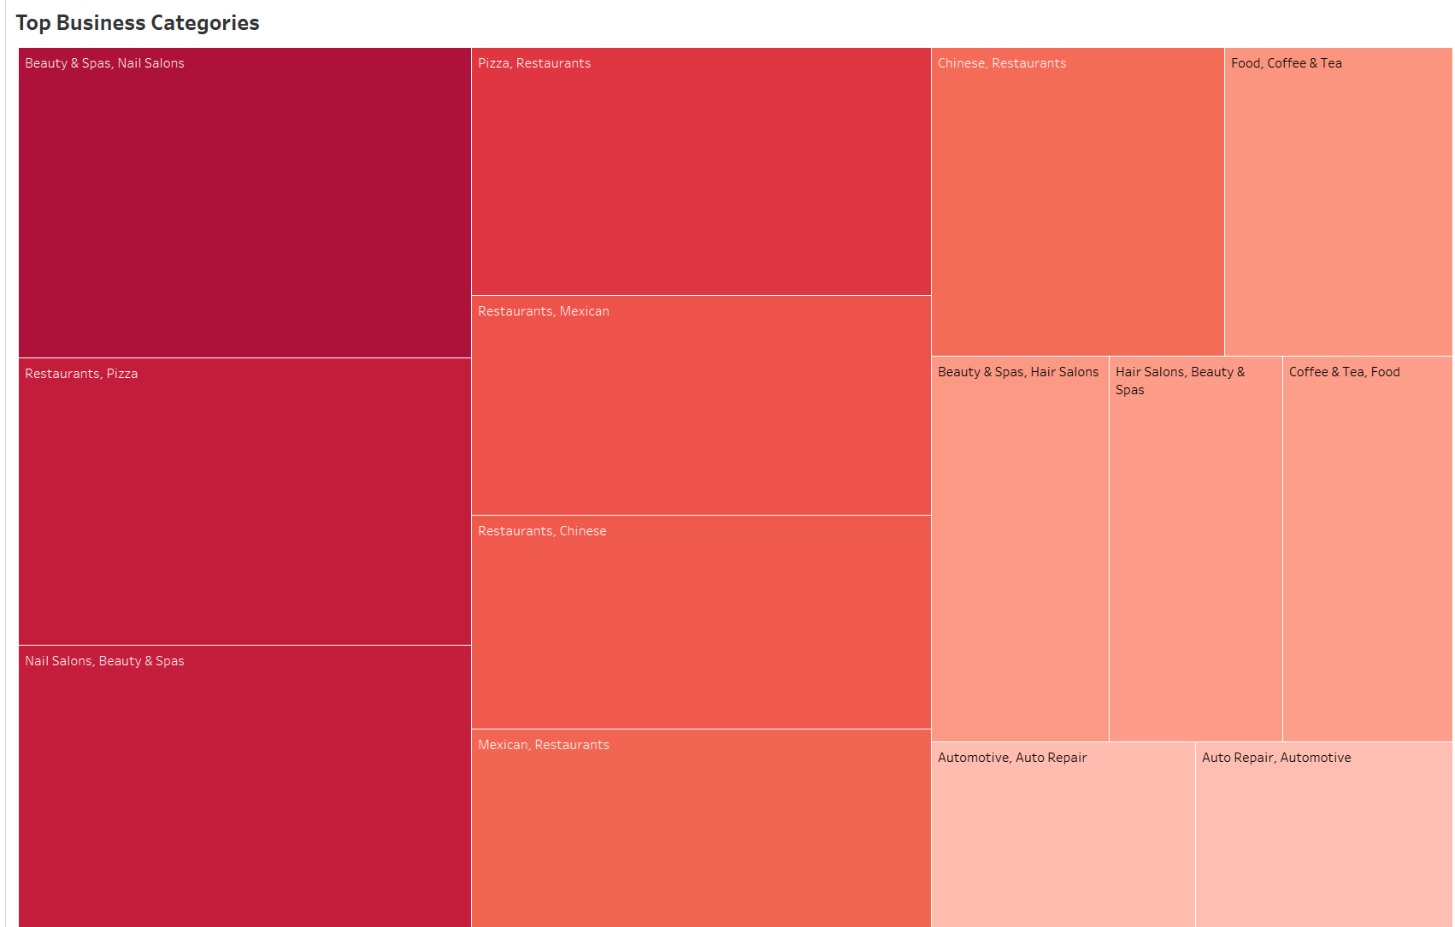
Top Business Categories

Slide 20

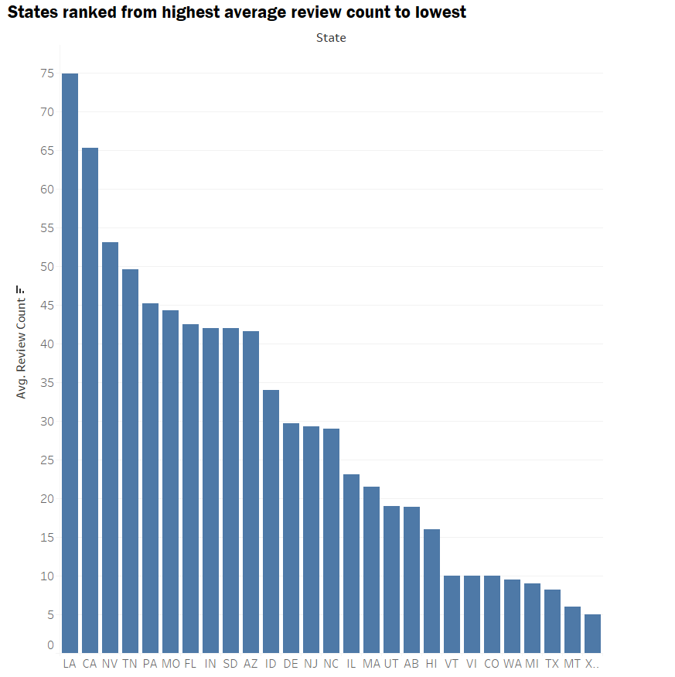
Average review counts in different states
Chart shows different states and their average review count providing valuable insights into how businesses in various states are performing based on customer reviews. This visualization can help identify states with higher or lower average review counts, potentially indicating the overall satisfaction levels of customers.

Slide 21
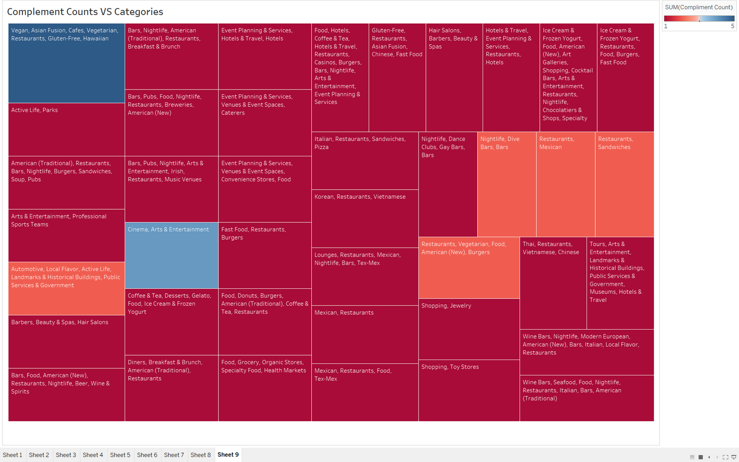
Complement Count VS Categories

Slide 22
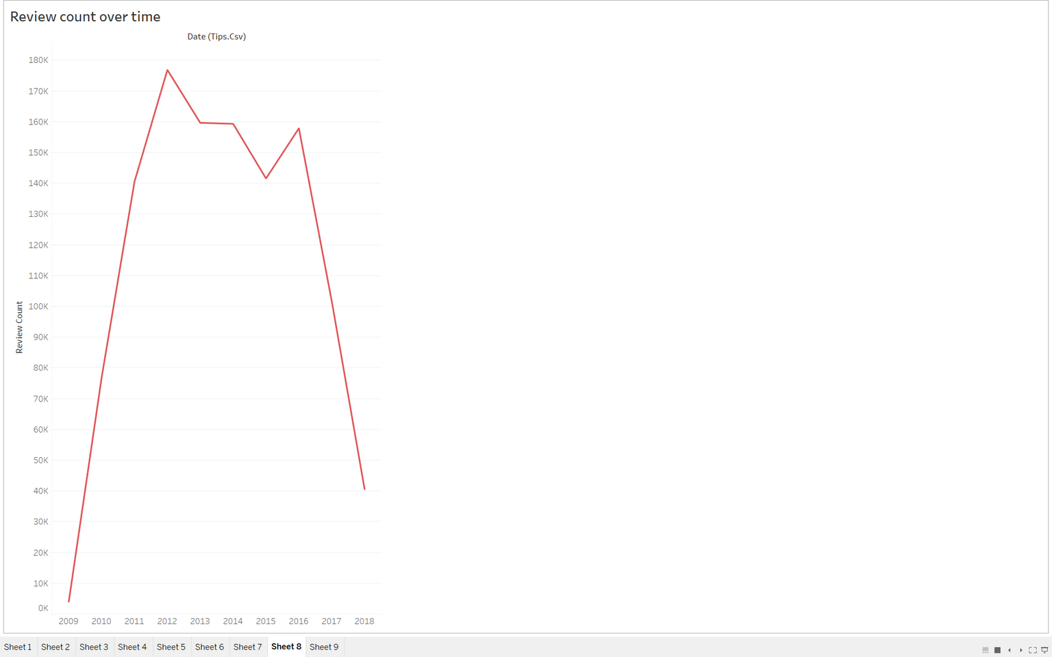
Review count trends over the years

Slide 23

Conclusion
The outlined prescription for enhancing Yelp's platform and user experience is a well-rounded approach that combines several key strategies. Prioritizing quality over quantity within business categories, fostering genuine user reviews, and refining personalized recommendations are essential steps.
Encouraging engagement during nighttime hours and empowering elite users contribute to a sense of community and enrich interactions.
Collaborating with top-reviewed businesses and leveraging sentiment analysis adds credibility and guides user choices. Seasonal promotions, continuous user engagement monitoring, and educating business owners further enhance the platform.

Slide 24

Thank You

